Slide 1
SI UNITS AND Significant Figures
Section 1.7-1.8

Slide 2
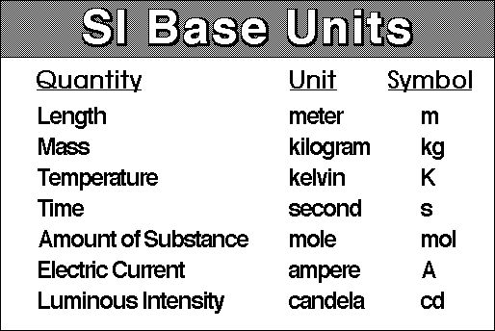

Slide 3
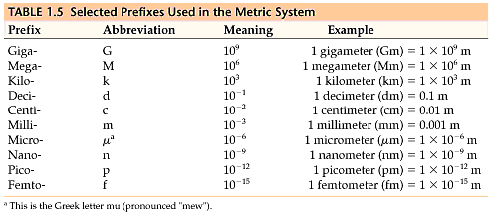
Prefixes of the Metric System

Slide 4
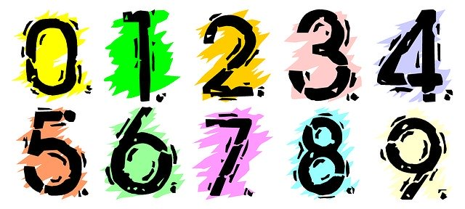
EXACT NUMBERS
  No uncertainty
  Counting
  Conversions
  Not used in rounding
INEXACT NUMBERS
  Uncertain
  Measurements
  Use these when rounding

Slide 5
Rules for Sig Figs
All nonzero digits are significant
    3542 has 4 sig figs
    2.52 x 10¹¹ has 3 sig figs
Zeros between nonzero digits are significant
    203 has 3 sig figs
Zeros at the beginning of a number are never sig figs
    0.0006 has 1 sig fig
Zeros at the end of a number are significant only
if the number contains a decimal point
    0.0300 has 3 sig figs
    200 has 1 sig fig

Slide 6
Sig Figs in Calculations
RULE 1: In multiplication and division- sig figs of the answer should be the same as the measurement with the fewest sig figs
    6.221cm x 5.2cm = 32.3492 cm² = 32 cm²

Slide 7
RULE 2: For addition and subtraction- final answer has the same number of decimal places as the measurement with the fewest decimal places.
    20.42 + 1.322 + 83.1 = 104.842 = 104.8

Slide 8
Intermediate Answers
If staying within the same Rule:
  Enter numbers one after another into calculator
  SAVE ROUNDING UNTIL THE END
If switching between Rules:
  You MUST round like a final answer before switching

Slide 9
Assignment
Page 30, numbers 24, 25, 28, and sig fig worksheet

